Slide 1
41183 PRIVACY PRESERVING
Lecture 4. Differential Privacy I

Slide 2
Notice
Studying is similar to sports training.
Assignment 1 is a GROUP work, due on week 7.
Do you have a group already?
What is your plan (following software engineering) ?
Do we have a plan to measure our delivery of Assignment 1 ?
Shall we reflect our performance of assignment 1 ?

Slide 3
Outline
The birth of differential privacy
Differentially privacy definitions
Differential privacy implementation
Differential privacy pros and cons

Slide 4
The Birth of Differential Privacy

Slide 5
Information Retrieval (IR)
IR is the critical part for us to find answers
Psychologically, we seek the storage of information, not the information itself (Science research).
AI training is essentially searching (the optimal path)
…
Application scenario: statistical information retrieval for someone’s salary ?

Slide 6
Information Retrieval (IR)
We need to protect privacy in IR at various perspectives
privacy of data owners, information seekers, …
However, the traditional tools, e.g., cryptographic solutions, are not suitable for the new application.
We need (invent) new tools!
Differential privacy (DP) is the privacy preserving tool in the scenario of information retrieval.

Slide 7

Dwork and Differential Privacy
Dwork was an expert of cryptography at Microsoft
Developed ε-differential privacy in 2006
Now a professor of Harvard, and fellow of National Academy of Sciences.
https://en.wikipedia.org/wiki/Cynthia_Dwork

Slide 8

Differential privacy almost is the only new mathematical tool for big data privacy
Collaboration with mathematicians
Transform ourselves to “mathematicians”
…

Slide 9



Privacy Model
A set of rules/assumptions to describe/measure the privacy of a dataset.
Privacy: (informal definition) adversary cannot learn anything new about particular individual after (multiple) accessing to the dataset
Alice
PM
Public Users or Entities
Original Dataset D
Bob
Curator
Cathy
Data Collecting
Data Release/Sharing

Slide 10
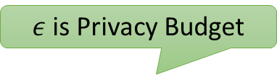


Differential Privacy Definition
Definition:
a mechanism M is $ε$-differential privacy if for all pairs of neighboring datasets D and D’, and for all possible output S, satisfy with:
$ε$is Privacy Budget
Pr[M()]
D
D’
Ratio Bounded $e^{ε}$
DP-Mechanism
S
neighboring datasets: there is maximum one item difference between D and D’

Slide 11
Typical Privacy Model
Method | Advantage | Disadvantage
Cryptography | Not decreasing accuracy; suitable for multiple parties computation | Computation complexity; people may not want to participant
Anonymization | Easy to understand Easy to implement for low dimensional dataset | No guarantee on the quality of the dataset; NP-hard for high dimensional dataset Weak privacy guarantee
Perturbation | Provide high privacy level | Noise size is subjective

Slide 12
Weakness of Traditional Privacy Model
Privacy level is difficult to be measured and compared
The privacy guarantee is hardly to be proved theoretically
Vulnerable to background attack

Slide 13
Differential Privacy
Typical scenario for differential privacy
Other scenarios ?
Statistical information retrieval
Maybe suitable, maybe not

Slide 14
2. Differential Privacy

Slide 15
Differential Privacy
An individual is in or out of the database should make little difference of the analytical output. Dwork, C. (2006). Differential Privacy
D
X1
Why does it work?
X2
f(D)
…
Output=S
Neighboring datasets: differ in a single record
Xn-1
Xn
D’
If adversary cannot tell the difference between the output of D and D’, then X_{n} is safe.
X1
X2
f(D’)
…
Output=S
Xn-1
Xn

Slide 16
An Example
There are 10 people’s salary D={6000, 7000, 6500, 8000, 7200, 9000,
7500, 6800, 7100, 7900}, their belongs to A, B, C,…
Attack:
avg= 7300 for 10 people (dataset D)
Remove A’s salary (6000 in this case) have dataset D’, what is the average? 804.4
attacker can figure out A’s Salary

Slide 17
Differential Privacy Definition
Definition:
a mechanism M is $ε$-differential privacy if for all pairs of neighboring datasets D and D’, and for all possible output S, satisfy with:
$ε$is Privacy Budget
Pr[M()]
D
D’
Ratio Bounded $e^{ε}$
DP-Mechanism
S
neighboring datasets: there is maximum one item difference between D and D’

Slide 18
How to achieve the definition?
Curator does not release a dataset, instead, a user submits statistical queries to the curator, and curator replies with query answers.
Add perturbation to the output
True answer is unique, but DP answer is a distribution.
Pr
True answer
S

Slide 19
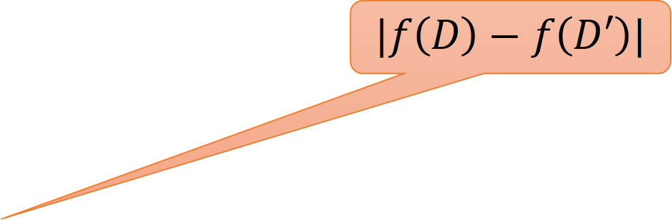
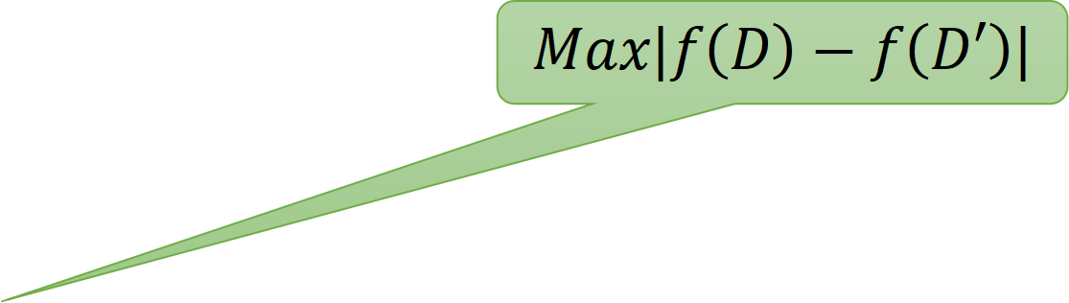
How to achieve the definition?
Add uncertainty to the output
perturbation: how much is enough?
Which Privacy Level? Privacy Budget ε
How much the difference (between query results on neighboring datasets) should be hide? Sensitivity
Pr
$$Max|f\left(D\right)−f\left(D′\right)|$$
$$|f\left(D\right)−f\left(D′\right)|$$
True answer
For D
True answer
For D’
S

Slide 20
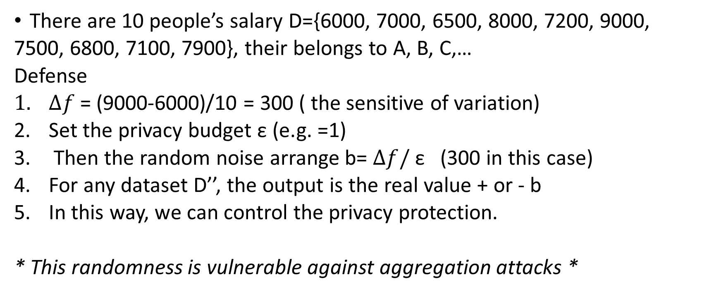
An Example (continue)
There are 10 people’s salary D={6000, 7000, 6500, 8000, 7200, 9000,
7500, 6800, 7100, 7900}, their belongs to A, B, C,…
Defense
$∆f$= (9000-6000)/10 = 300 ( the sensitive of variation)
Set the privacy budget ε (e.g. =1)
Then the random noise arrange b= $∆f/$ ε (300 in this case)
For any dataset D’’, the output is the real value + or - b
In this way, we can control the privacy protection.
* This randomness is vulnerable against aggregation attacks *

Slide 21
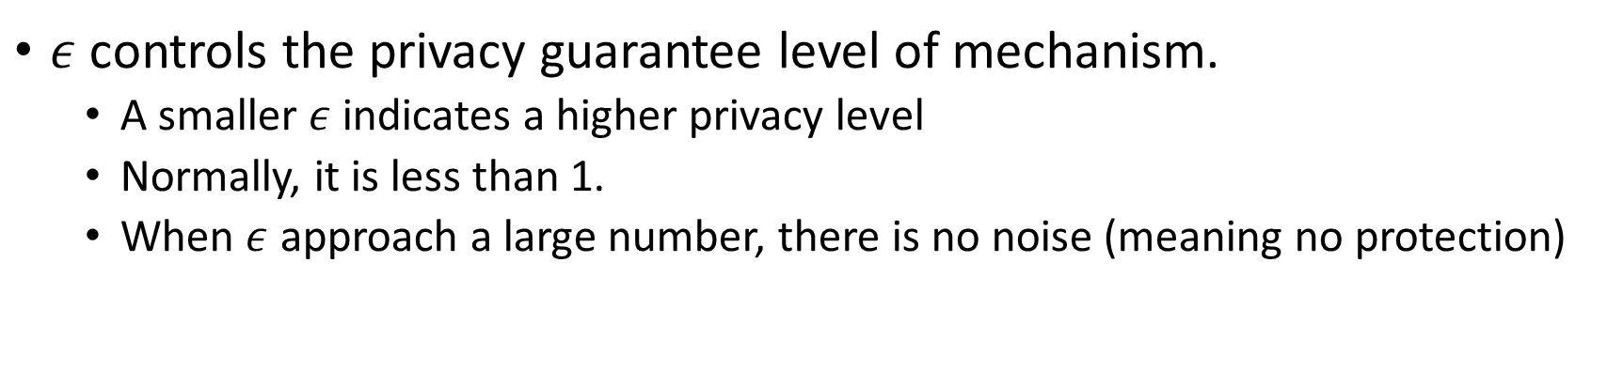
Privacy Budget
$ε$ controls the privacy guarantee level of mechanism.
A smaller $ε$ indicates a higher privacy level
Normally, it is less than 1.
When $ε$ approach a large number, there is no noise (meaning no protection)

Slide 22
Primary noises for DP
Laplace Mechanism:
suitable for numeric output
How many people in this room have blue eyes?
Exponential Mechanism:
suitable for non-numeric output
What is the most common eye color in this rooms?
Dwork, C., Mcsherry, F., Nissim, K., & Smith, A. (2006). Calibrating Noise to Sensitivity in Private Data Analysis, Theory of Cryptography , 265-284.
McSherry, F., & Talwar, K. (2007). Mechanism Design via Differential Privacy. (FOCS’07)

Slide 23
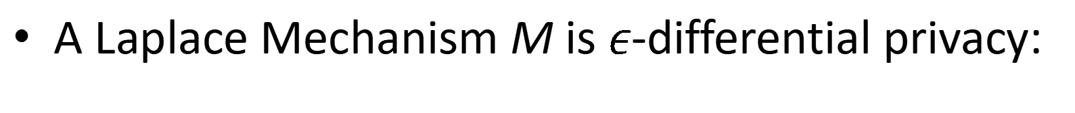
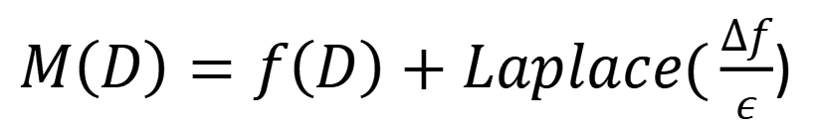

Laplace Mechanism
Let f(D) be a numeric query on dataset D
How many people in this room have blue eyes?
The sensitivity of f: $∆f=max∥f\left(D\right)−f\left(D^{′}\right)∥_{1}$
M(D)
X1
f(D)
X2
+noise
True answer
Noisy output S
Xn-1
Xn
A Laplace Mechanism M is $ε$-differential privacy:
$M\left(D\right)=f\left(D\right)+Laplace(\frac{∆f}{ε}$)
True Answer
Noise
Notes:
Emphasis lap mech

Slide 24
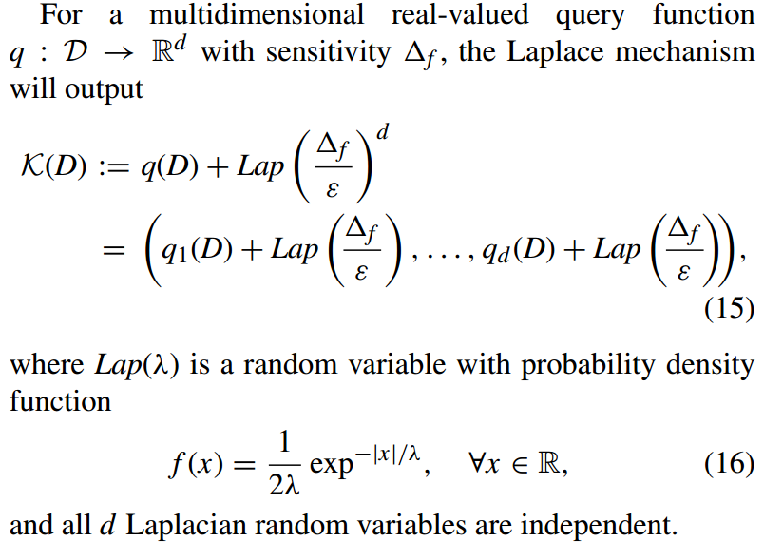
Laplacian noise

Slide 25
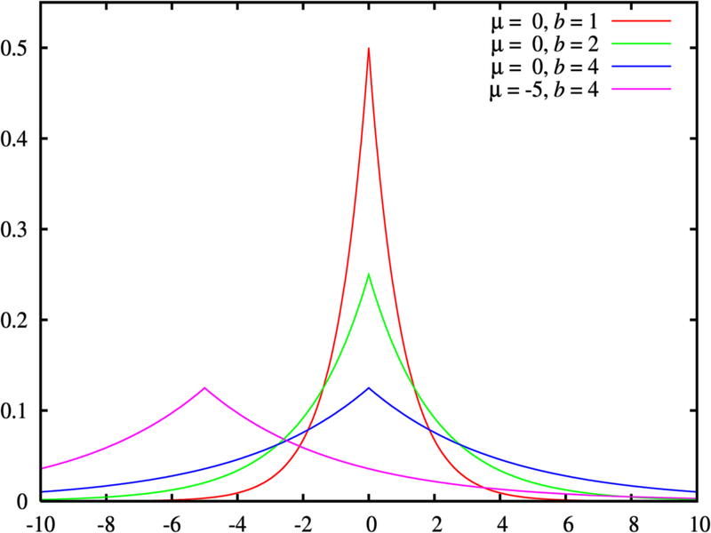
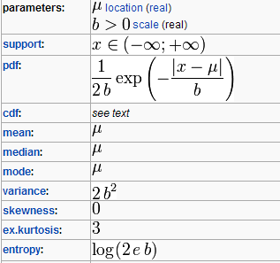
Laplace distribution noise

Slide 26
Advantage of Differential Privacy
Differential privacy is a promising privacy model that can provide provable privacy guarantee.
It also has potential development on various research communities such as data mining, machine learning, etc.

Slide 27
Disadvantage of Differential Privacy
It is quite successful on the mathematical theory, but brings (huge) utility loss in real applications.
High noise
Large sensitivity
Sparse Dataset
Limited privacy budget
…

Slide 28

Thank you & Questions http://www.uts.edu.au/syu email: shui.yu@uts.edu.au

